Slide 1

Crop Performance Analysis
-Priyesh Subhash Patil
AICTE ID:
STU61724cd0bbae61634880720

Slide 2

Problem Statement
Crop Diversity: Different types of crops are grown in various regions.
Regional Differences: Crop production varies between states and districts.
Seasonal Impact: The season in which crops are grown affects their production.
Production Discrepancies: Some areas produce more crops compared to others.
Challenges for Farmers: Farmers face difficulties in achieving consistent crop yields.
Opportunities for Improvement: There are opportunities to improve farming practices and policies to address these challenges.
Understanding Crop Years: Crop production can change from year to year due to various factors.

Slide 3
Project Description
Objective: This project aims to analyze crop production data from various regions to identify patterns, disparities, and opportunities for improvement in agricultural practices.
Scope: It covers data from different states and districts across multiple years and seasons, providing a comprehensive overview of crop production dynamics.
Methodology: The analysis involves examining crop yield, area under cultivation, and production levels for different crops to understand the factors influencing agricultural productivity.
Key Findings: The presentation will highlight notable disparities in crop production between regions, seasonal variations in yield, and potential challenges faced by farmers.

Slide 4
Project Description
The key points are:
Data Analysis: This project focuses on analyzing agricultural data in India.
Focus: I am exploring crop production trends across various states, seasons, and years.
Goal: Identify potential relationships between factors affecting crop production.
Outcome: Gain valuable insights to inform agricultural practices and decision-making.

Slide 5
WHO ARE THE END USERS?
Farmers
Government Agencies
Agriculture Organizations
Researchers and Scientist
Agribusinesses
Consumers
Environmental Groups
International Organizations

Slide 6

Technology Used
The technology stack used in this crop performance analysis project includes:
Power BI for data analysis and visualization.
Direct Query Editor
Built-in Visualization
Data Storage: Excel File or CSV (Comma-Separated Values) file format for storing and accessing the dataset.
Data Import/Export Tools: Depending on the data format (CSV, Excel, etc.)

Slide 7
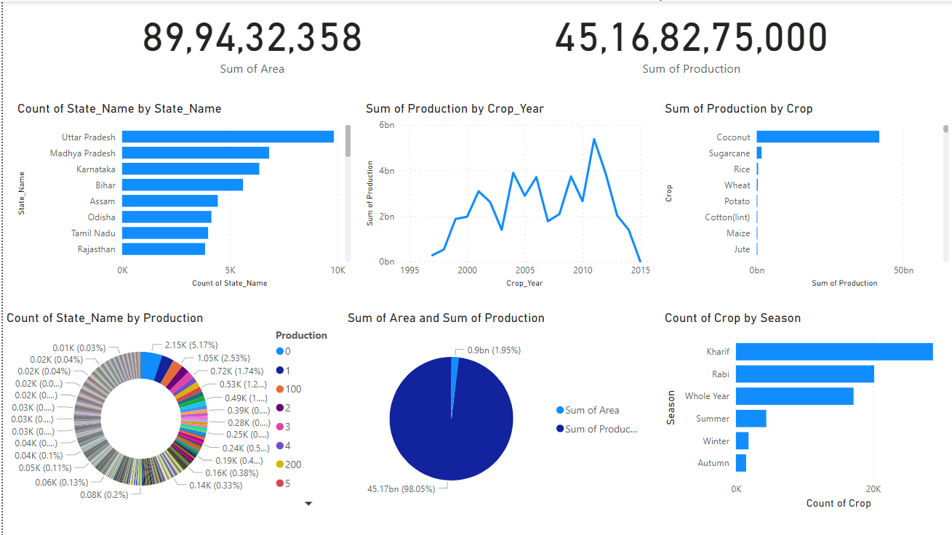
RESULTS

Slide 8
Thank you
Any Questions?
.
.

